Slide 1




CI PI PELI NE PROJECT
USING JENKINS AND GITHUB
Presented by :
Prince Kumar
Presented to :
Mr. ASHISH MITTAL

Slide 2
INTRODUCTION
CI/CD (Continuous Integration/Continuous Delivery) is a holistic DevOps process that focuses on creating a compatible blend between the development cycle and the operations process. This is done by automating workflows and rolling out automatic updates to improve ROI. The CI/CD pipeline implementation is the backbone of the entire DevOps paradigm and facilitates the process of introducing the product to the marketplace faster than ever before.

Slide 3


CI is not entirely an essential prerequisite required for creating a stable software product. However, it definitely serves an important role when developing software products or components that require frequent changes. Furthermore, it also ensures that all the components of an application are integrated properly.
In the SDLC, CI mainly covers the Source and Build phases. A CI pipeline typically involves these steps:
Detect changes in the code
Analyze the quality of the source code

Slide 4

Build
Execute all unit tests Execute all integration tests
Generate deployable artifacts
Report status
If any of the above steps fail, the integration stops immediately, and the team is notified about the result.

Slide 5
STEPS
To configure CI pipeline with Jenkins, the first and the most obvious step is to install Jenkins. Follow the steps to do so :
Launch an instance of Redhat (instance type t2.small/t3.small) . Also allow port 8080 in security group while launching .
Login into the machine using SSH on Command Prompt. Now execute the following commands to install jenkins :
sudo -i
yum install wget -y
sudo wget -O /etc/yum.repos.d/jenkins.repo \ https://pkg.jenkins.io/redhat-stable/jenkins.repo sudo rpm --import https://pkg.jenkins.io/redhat- stable/jenkins.io-2023.key

Slide 6
sudo yum upgrade
sudo yum install java-17-openjdk sudo yum install jenkins
sudo systemctl daemon-reload
Following screenshots of the executed commands are attached for reference .You can also visit to “ https://www.jenkins.io/doc/book/installing/linux/#red-hat-centos” to see the manual and commands for installing jenkins on Red Hat Linux.

Slide 7
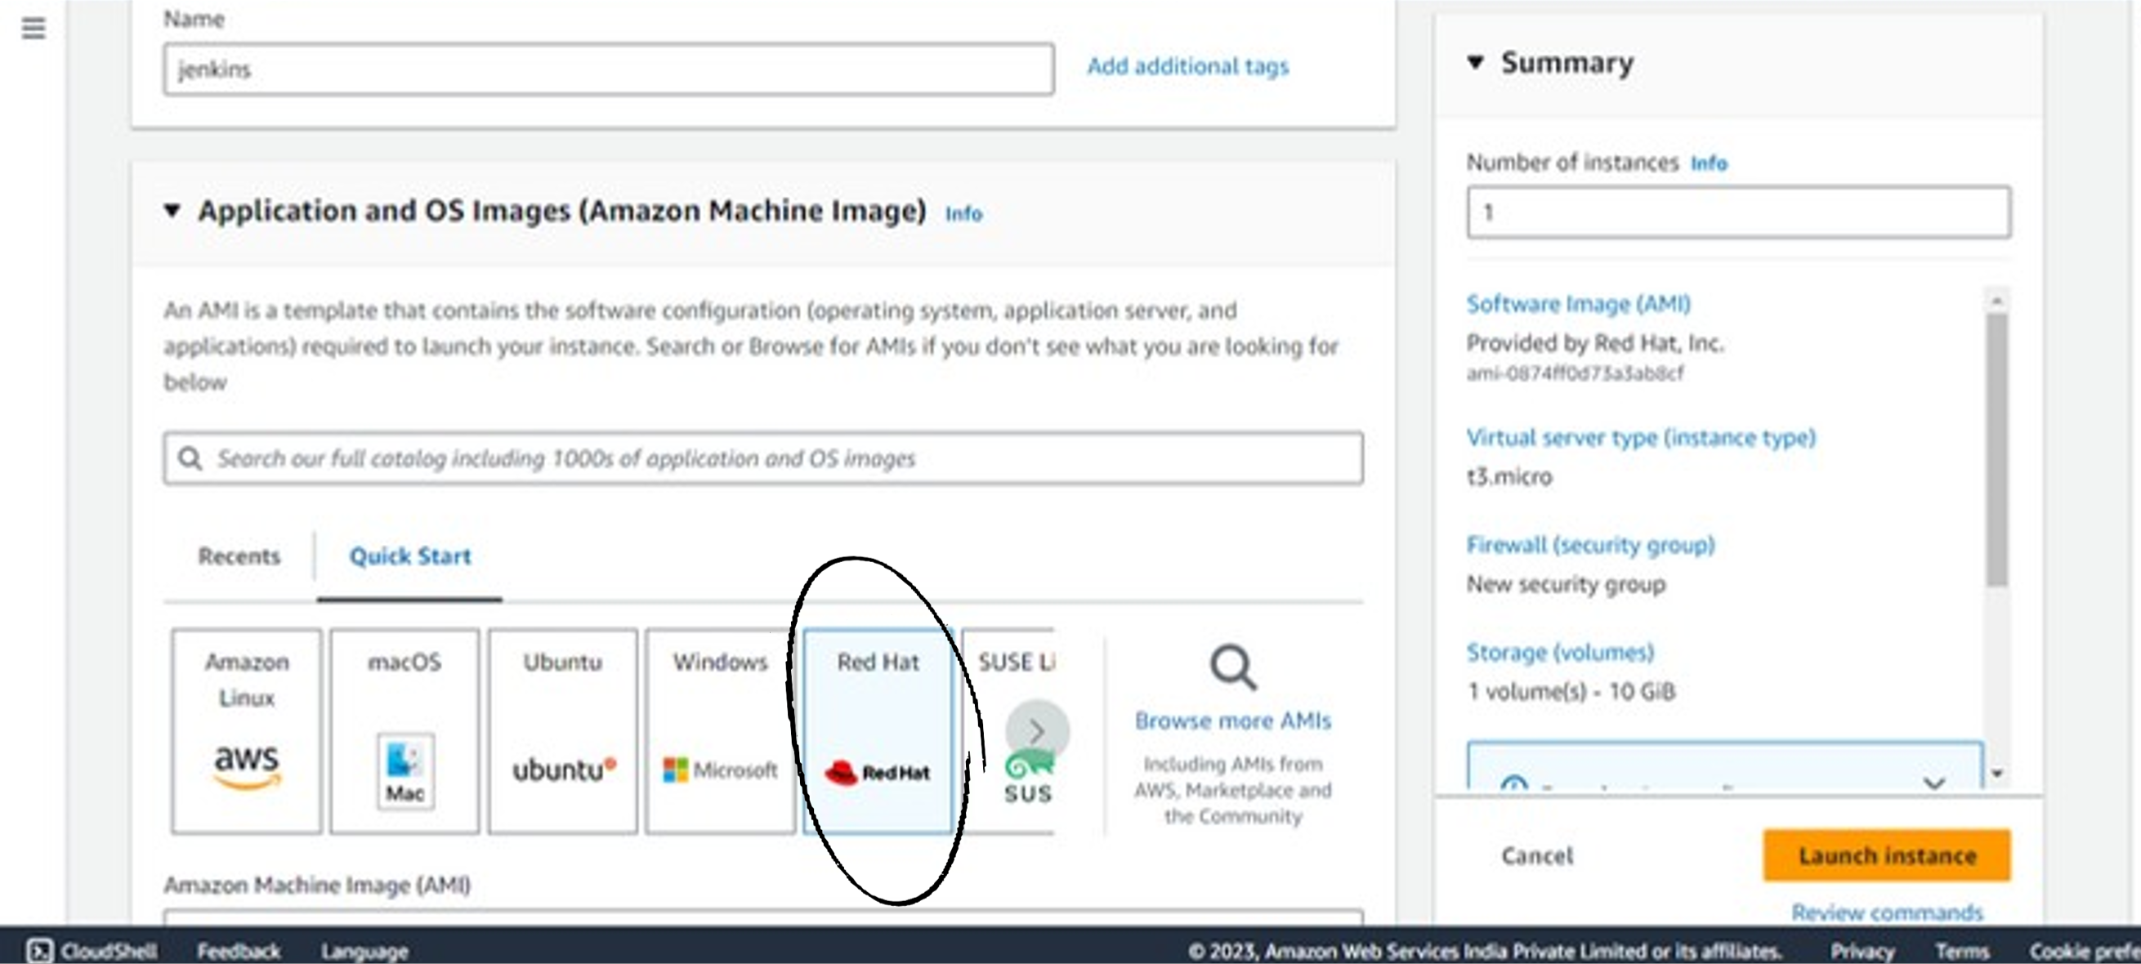

Slide 8
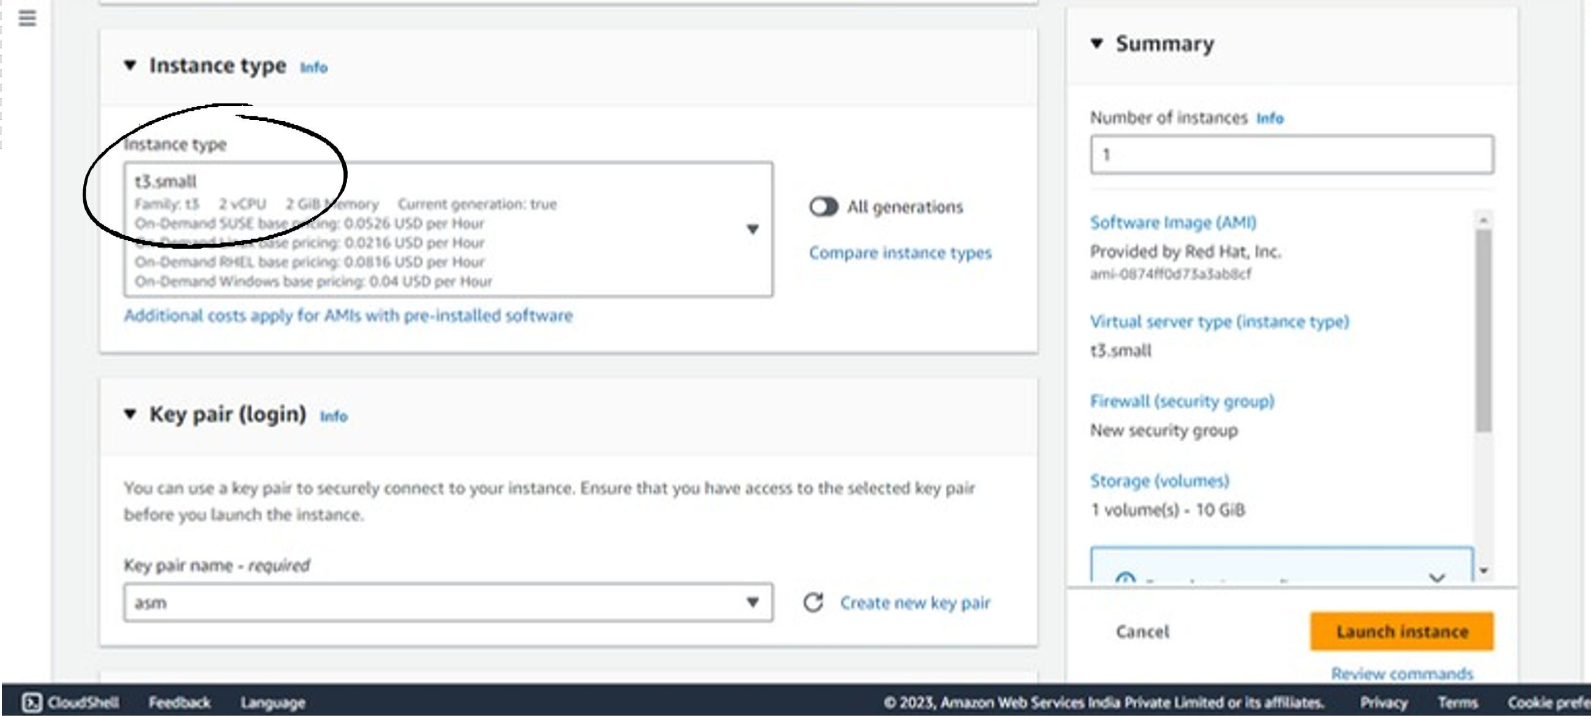

Slide 9
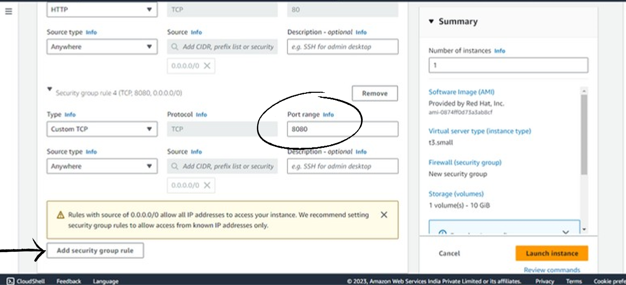

Slide 10
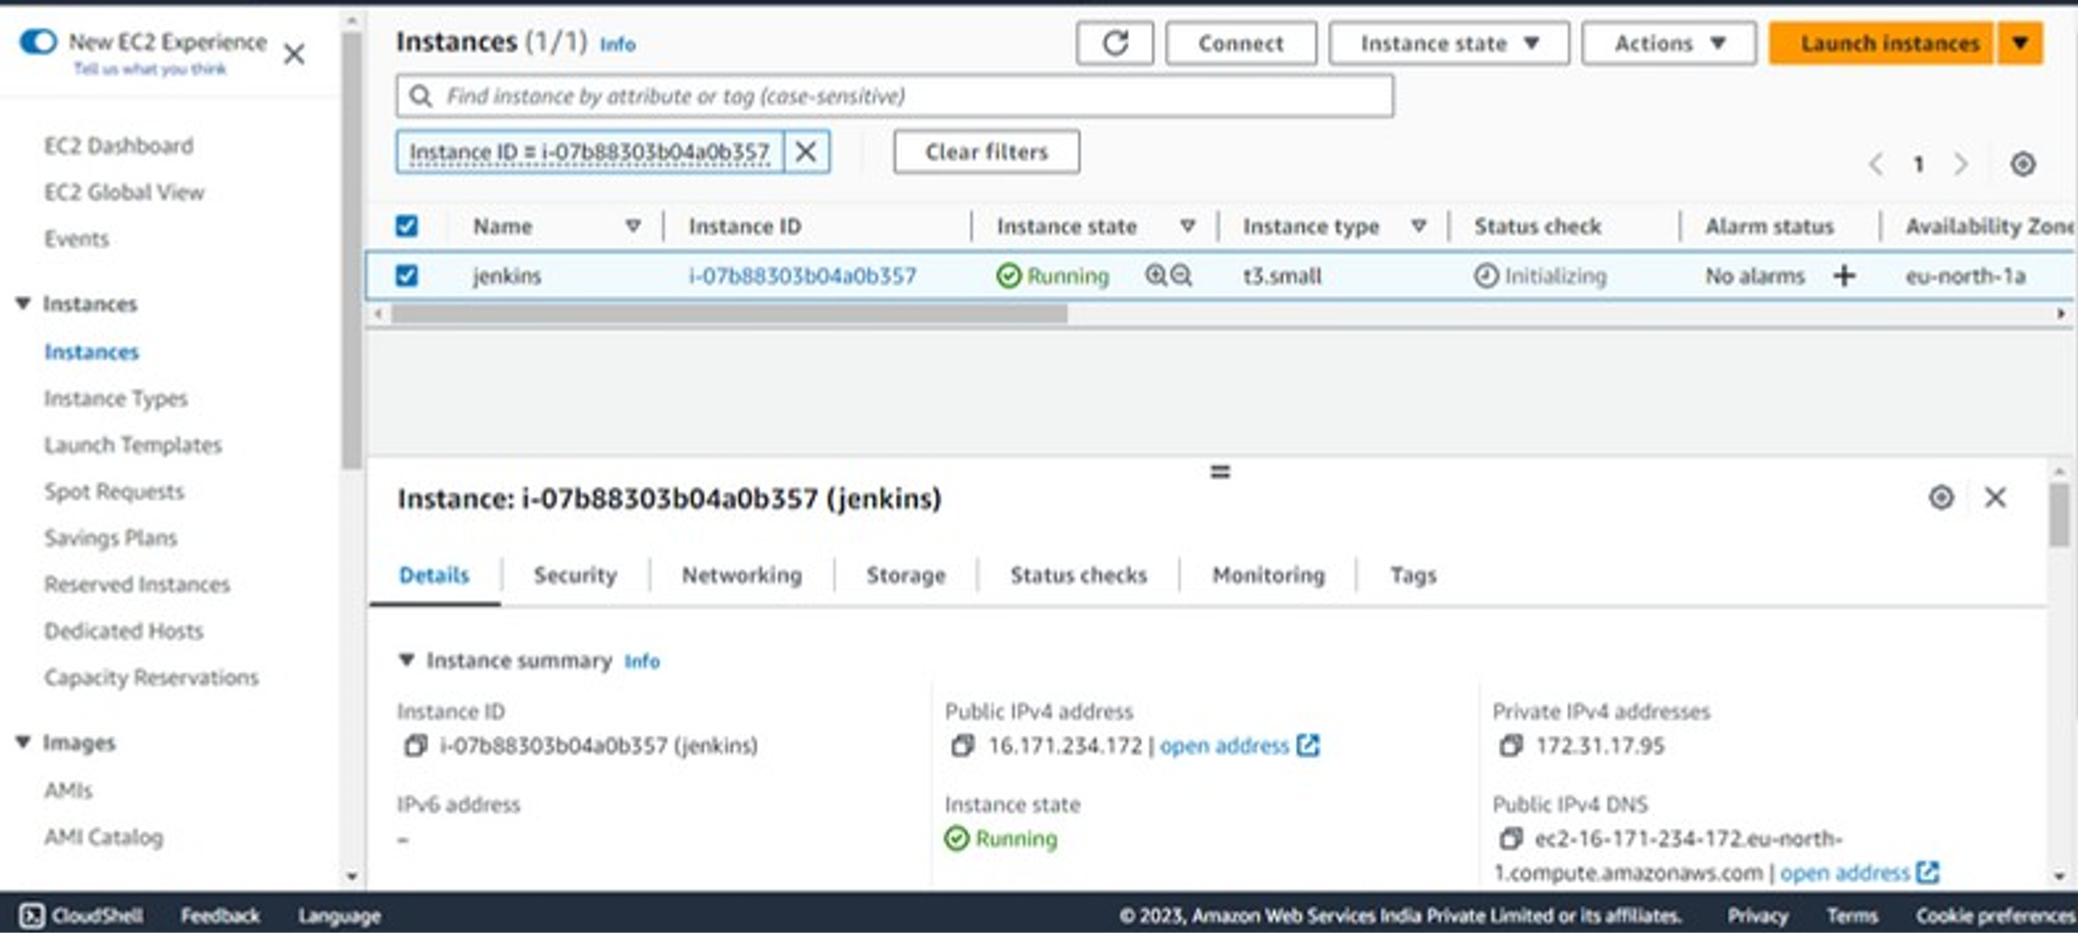

Slide 11
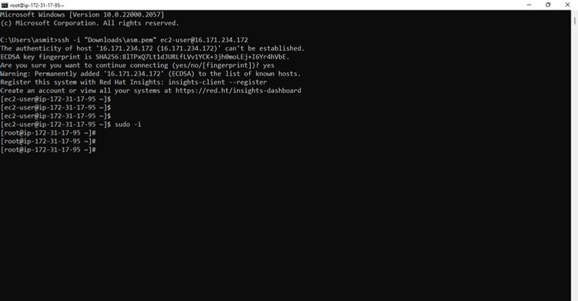

Slide 12
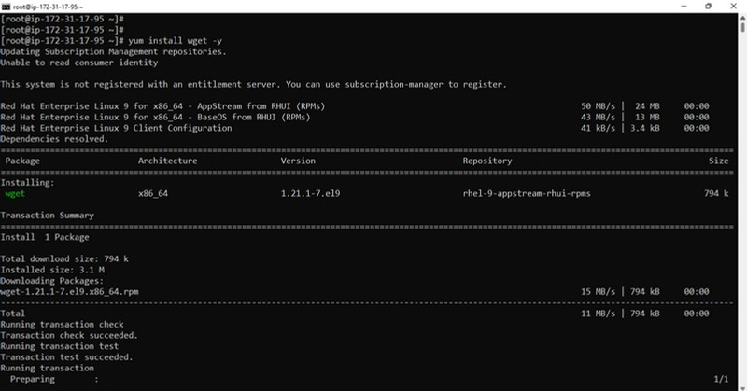


Slide 13
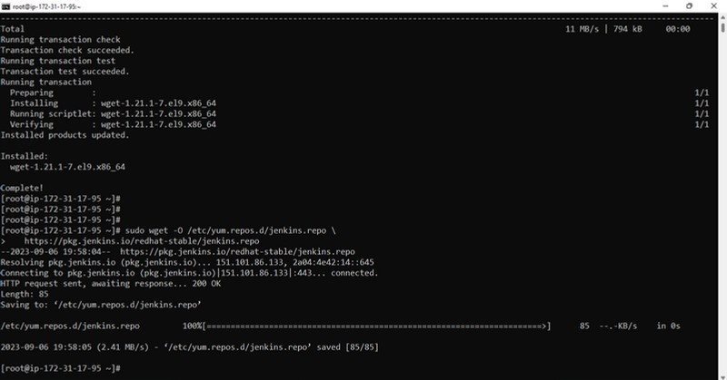

Slide 14
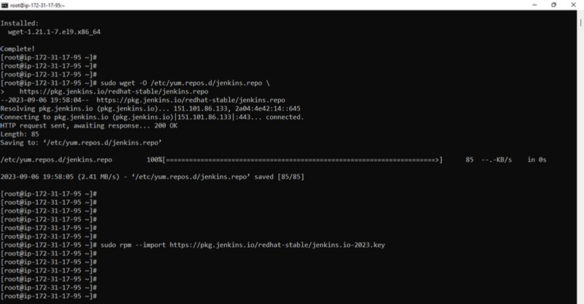

Slide 15
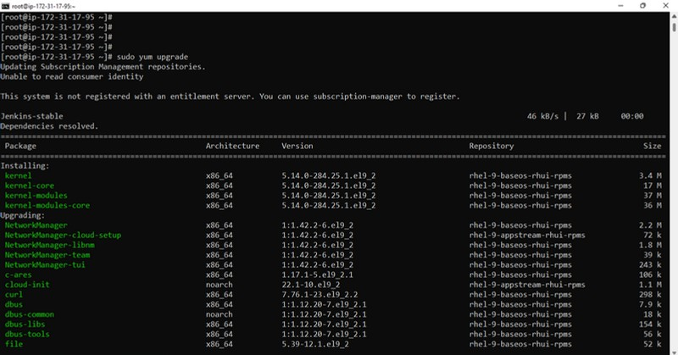

Slide 16
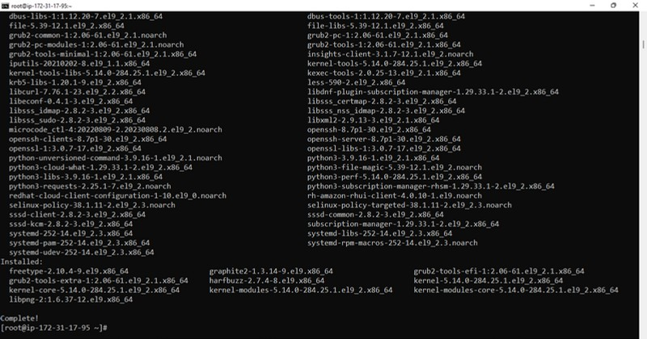

Slide 17
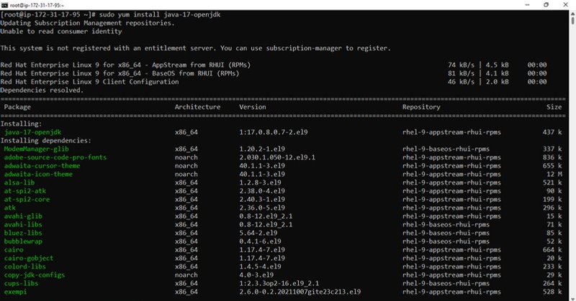

Slide 18
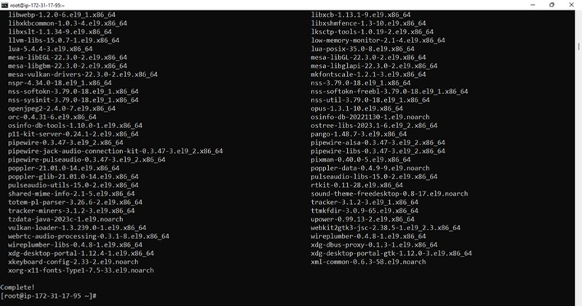

Slide 19
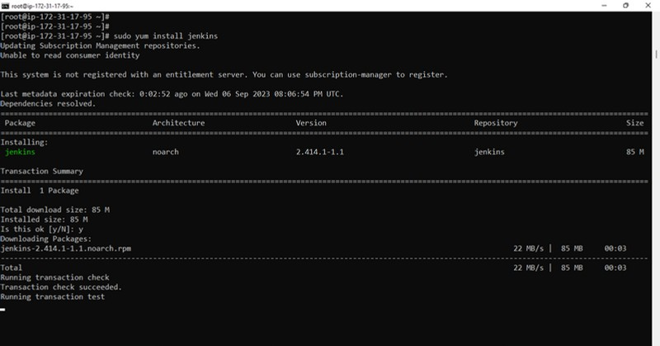

Slide 20
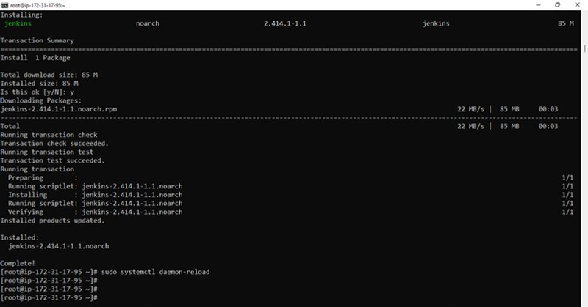

Slide 21

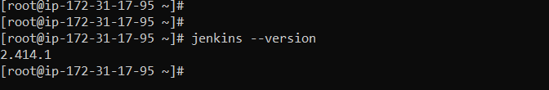
Check the installed jenkins version :
jenkins --version
Now enable the jenkins service using following command :
systemctl enable --now jenkins
Now paste the “publicIP:8080" on browser to see jenkins login page . For example :

Slide 22

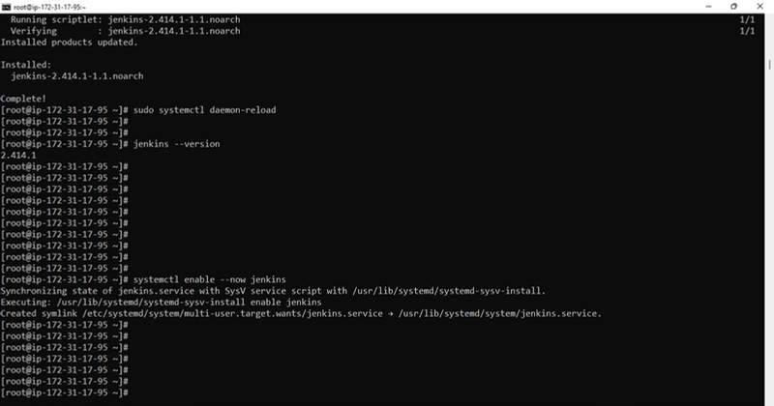

Slide 23

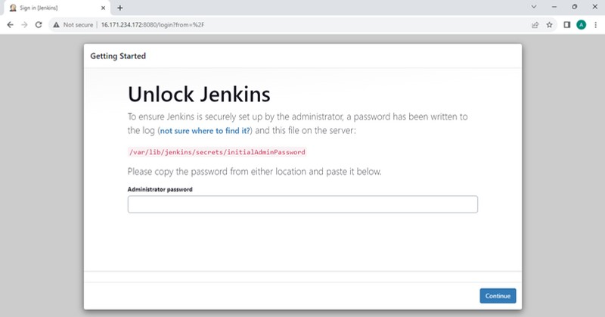
To unlock this, open the following file in terminal and paste the password here :
cat /var/lib/jenkins/secrets/initialAdminPassword

Slide 24

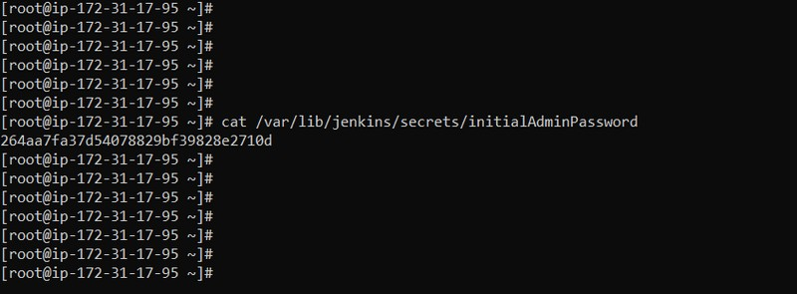

Copy and Paste this password in the jenkins server page .
password

Slide 25

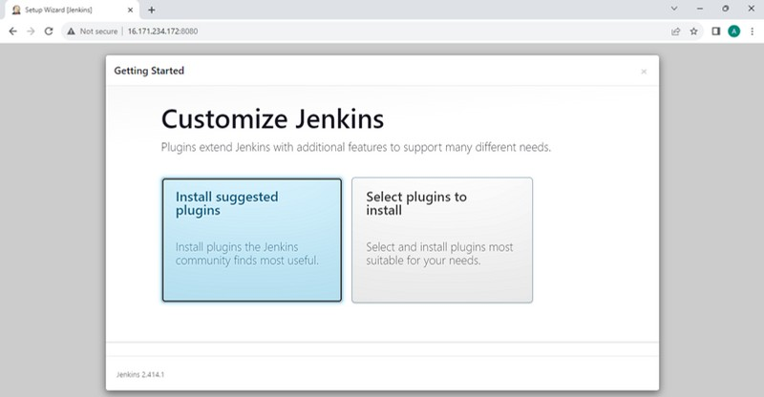
Click on install suggested plugins.

Slide 26

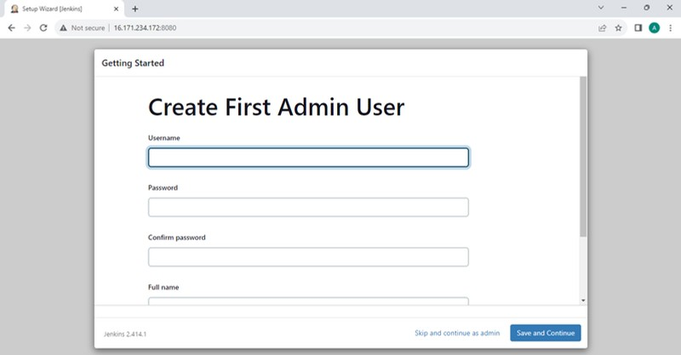
Click on skip and continue as admin.

Slide 27
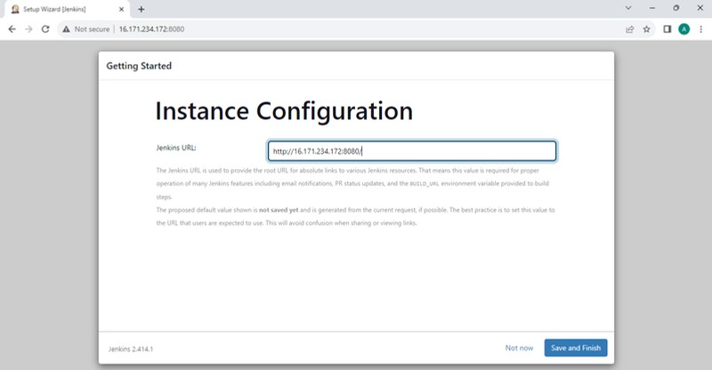
Click on Save and finish.

Slide 28

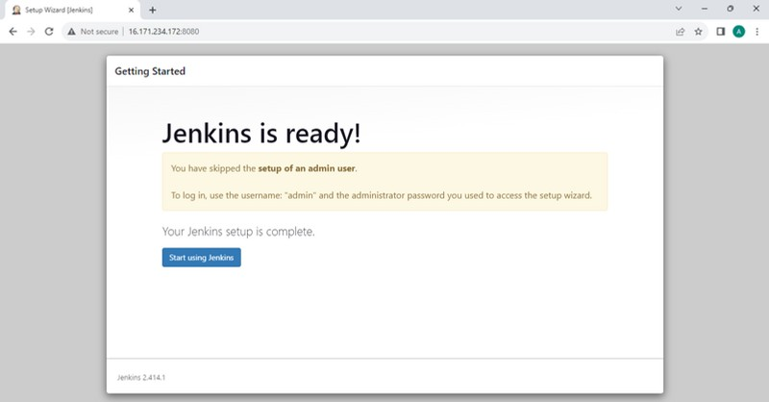
Click on Start using Jenkins.

Slide 29

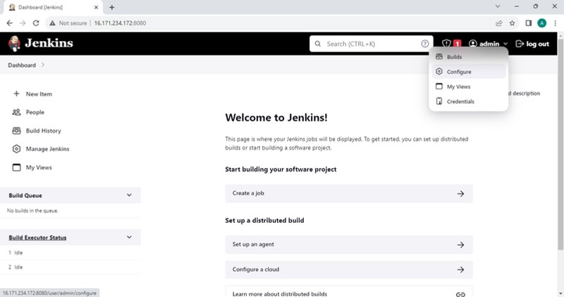

Go to Admin -> Configure -> scroll down to set custom password.

Slide 30
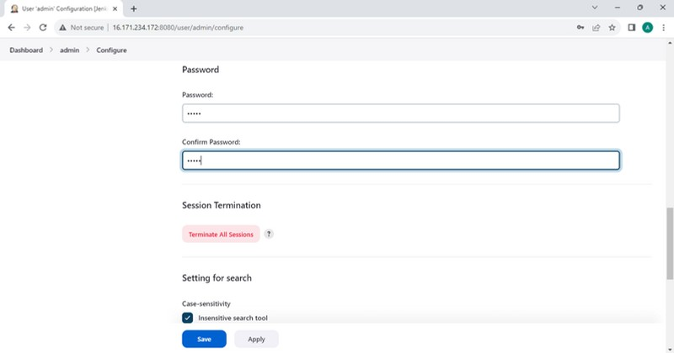
Type and confirm the new password and then apply and save it .

Slide 31
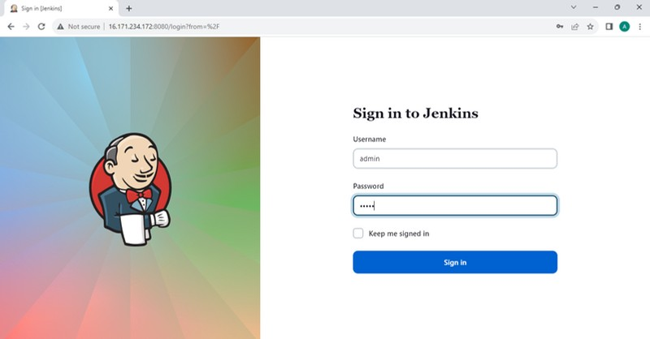
Login again using your credentials.

Slide 32
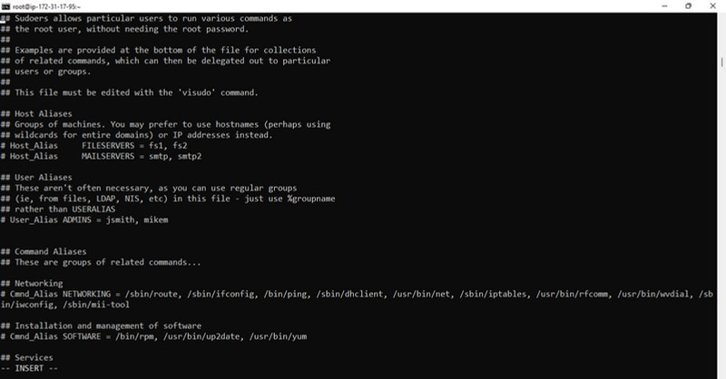
Providing root permissions to Jenkins
Open terminal and fire “sudo visudo”. A file gets opened , scroll down to “#Allow root to run any command anywhere.”

Slide 33
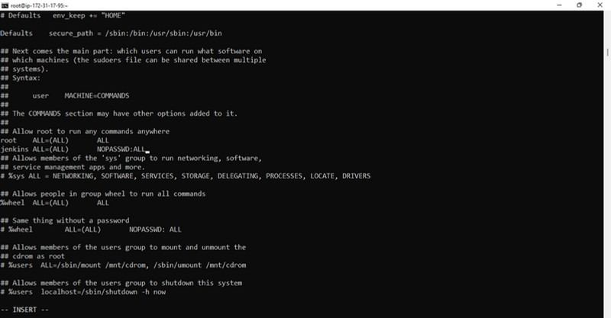

Add the following with proper alignment as shown :
jenkins ALL=(ALL) NOPASSWD:ALL

Slide 34
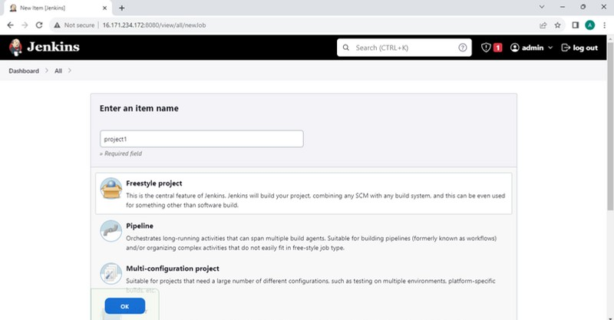
On jenkins page click on : New item -> project name -> freestyle project -> Ok

Slide 35
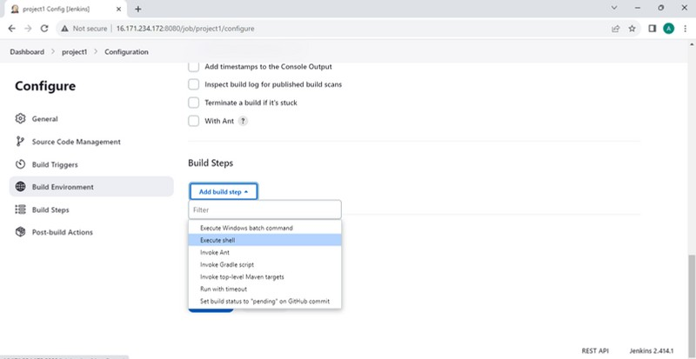
Scroll down to build steps -> add build steps -> execute shell.

Slide 36
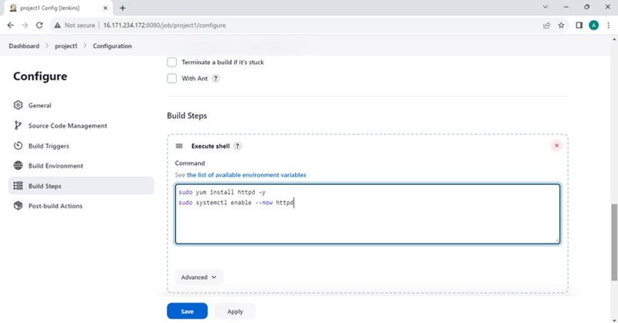
Type the following commands in execute shell box as shown then apply and save :
sudo yum install httpd -y
sudo systemctl enable --now httpd

Slide 37
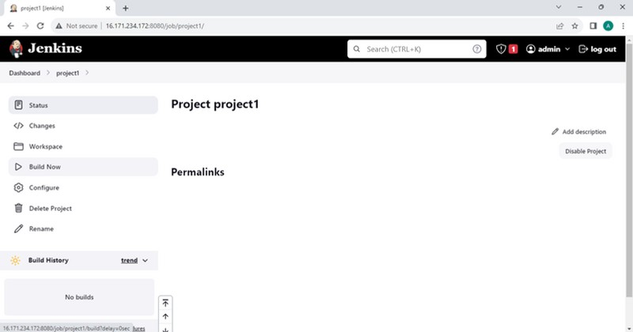
Click on Build now.

Slide 38
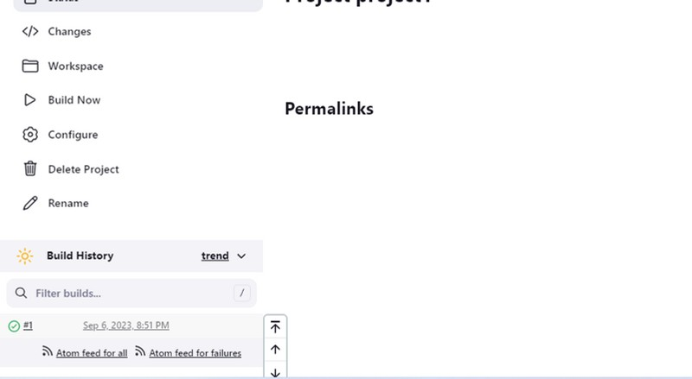

Green color indicates that your build is successful.

Slide 39
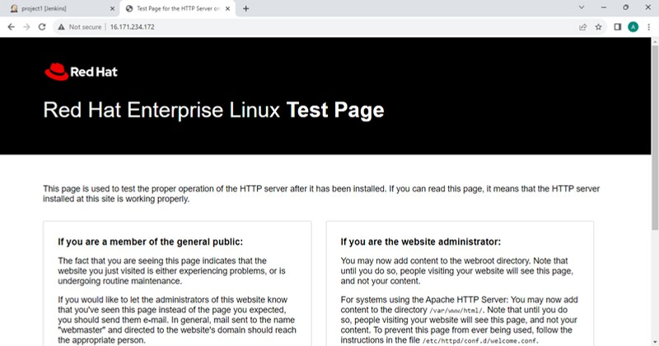
Paste the public IP on google to see the default httpd page.

Slide 40
Git Installation and working part
Launch a machine named “developer” and install git on it.
Now login to machine(using ssh) and execute the following set of commands :
sudo -i
yum install git -y
git --version
4. mkdir d1
5. cd d1/
6. vi index.html | -> | “write | anything” | -> | save | and | exit.
7. vi asmit.html | -> | “write | anything” | -> | save | and | exit.
8. git init
9. git add *
10.git commit -m “Write Commit message“
Following screenshots shows one by one execution of the above commands

Slide 41
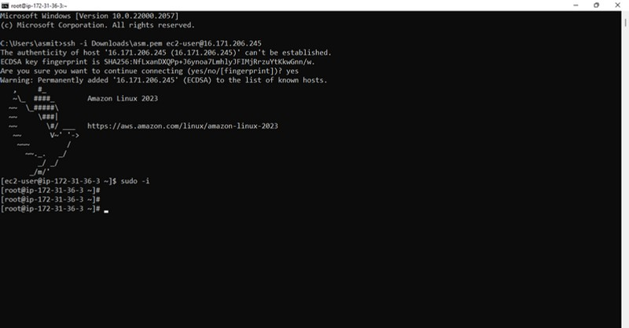


Slide 42
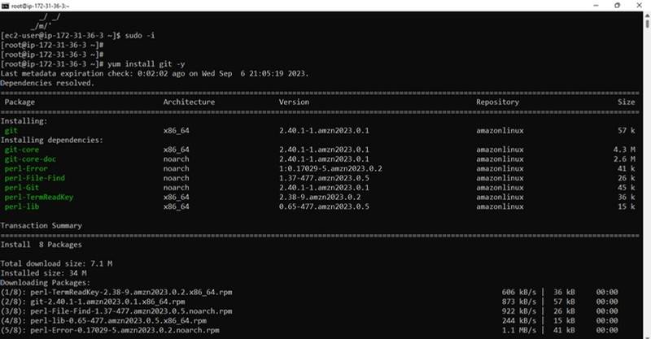

Slide 43
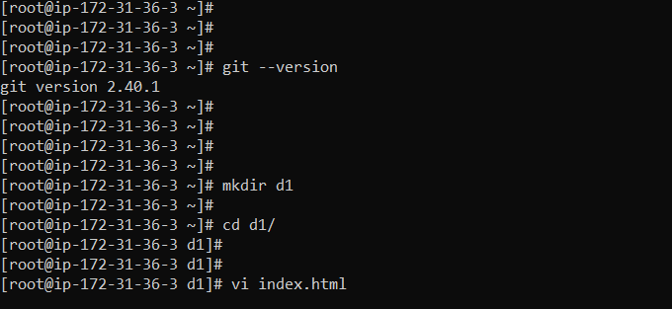

Slide 44
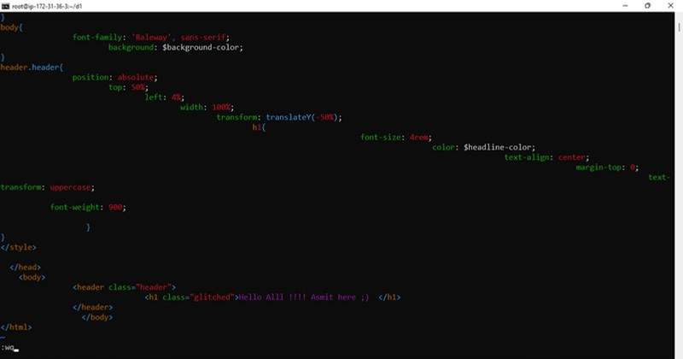
HTML code , one can write simple text also . Save and exit and do similarly for “prince.html”.

Slide 45
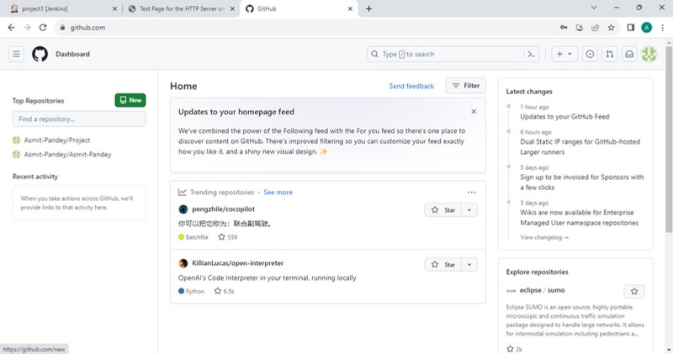
Open “https://github.com/” and login and do following as shown : Create a New repo -> Name it -> Click on create repo.

Slide 46
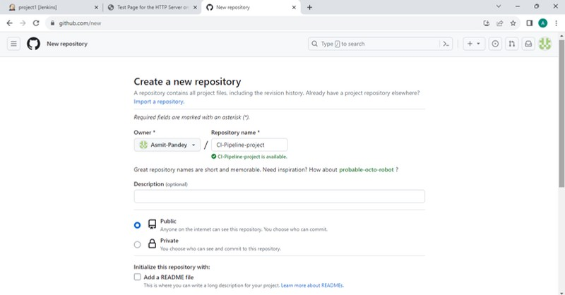

Slide 47
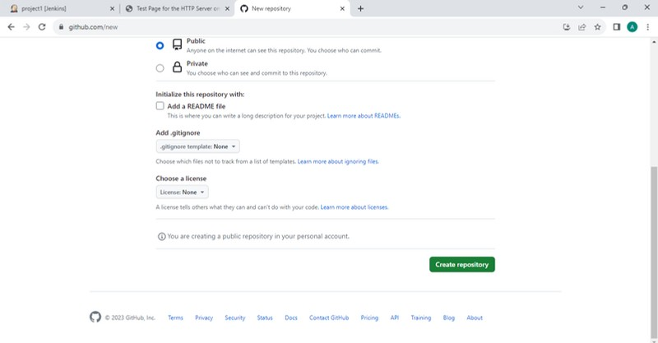

Slide 48
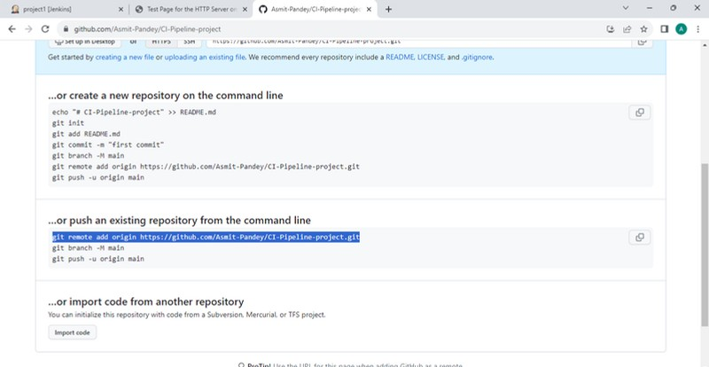

Scroll down & copy the following command.

Slide 49
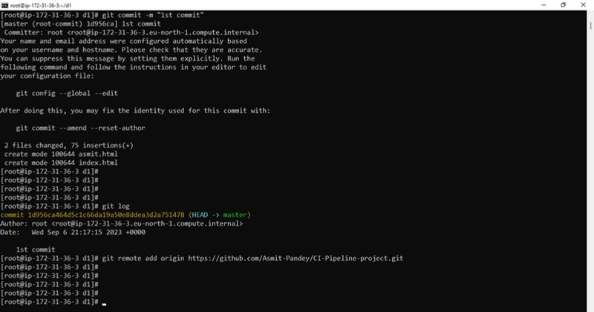

Paste the copied command in developer machine.& hit enter.

Slide 50
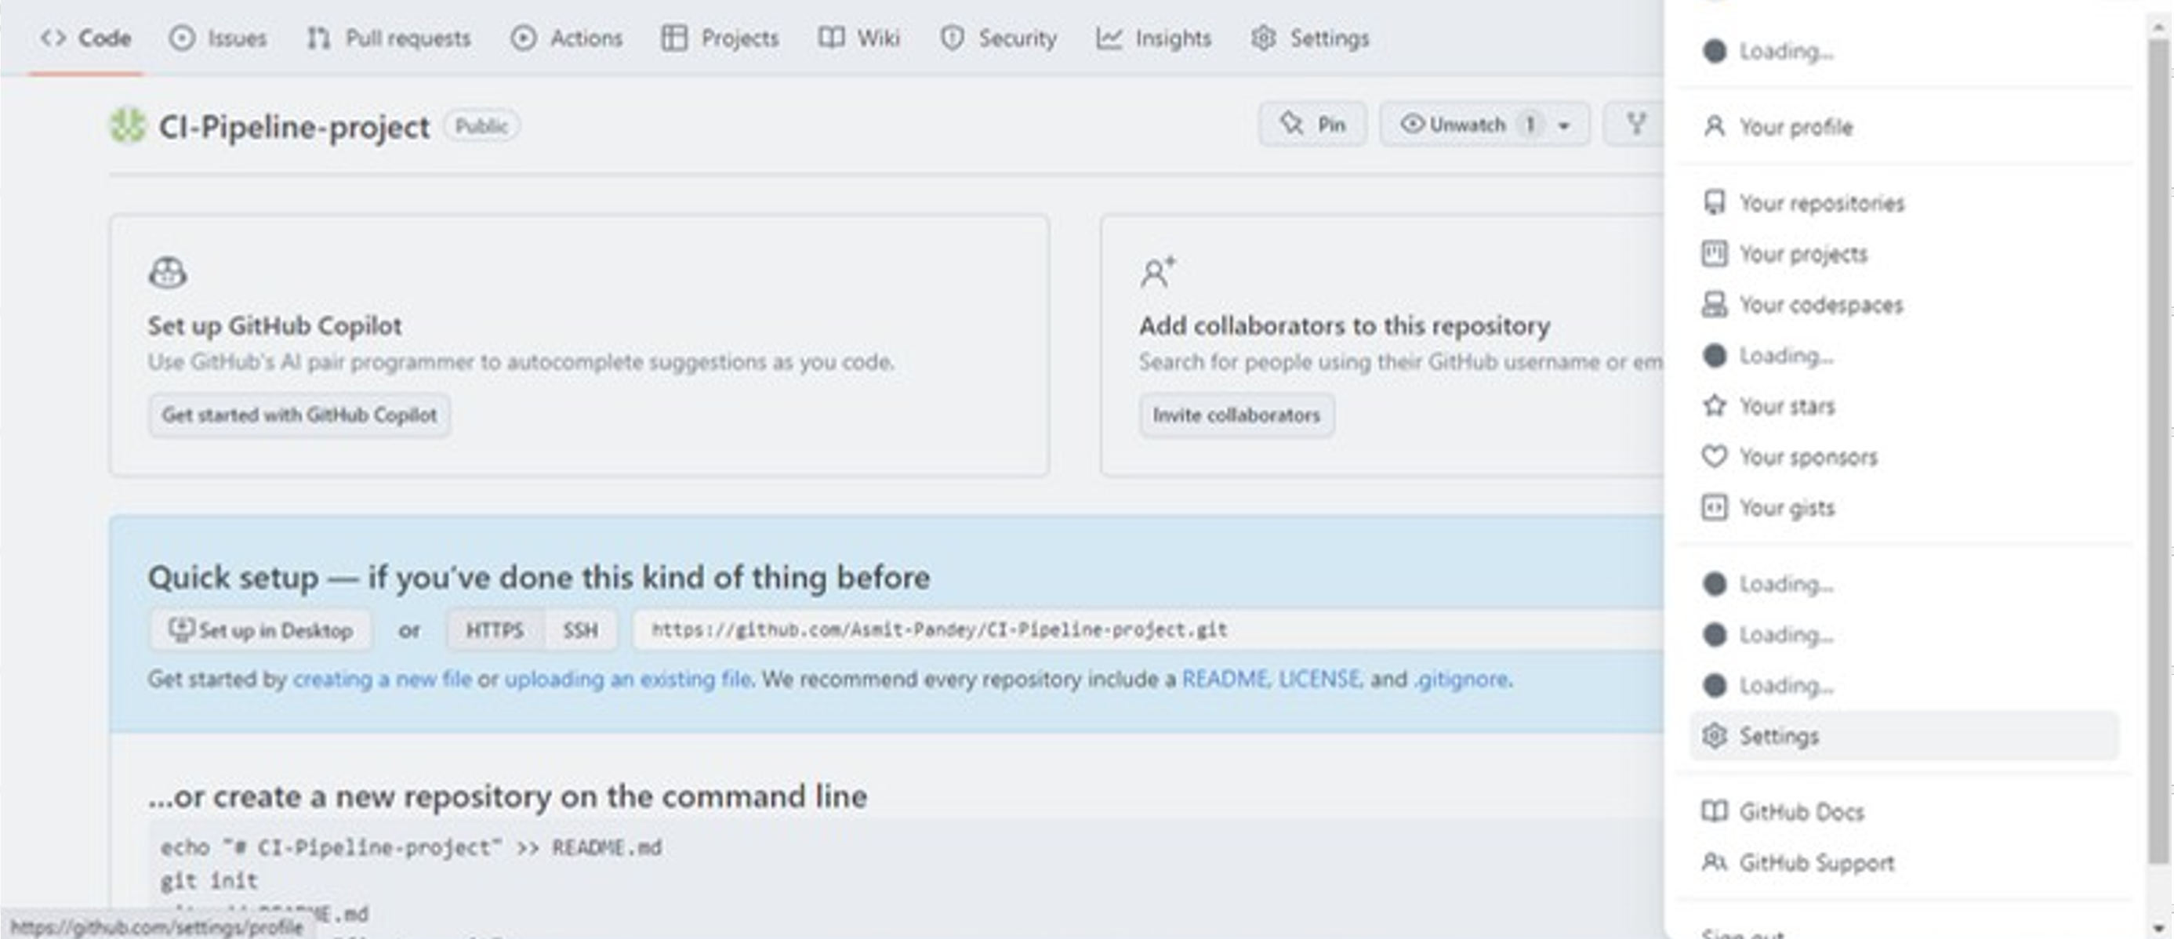


Slide 51
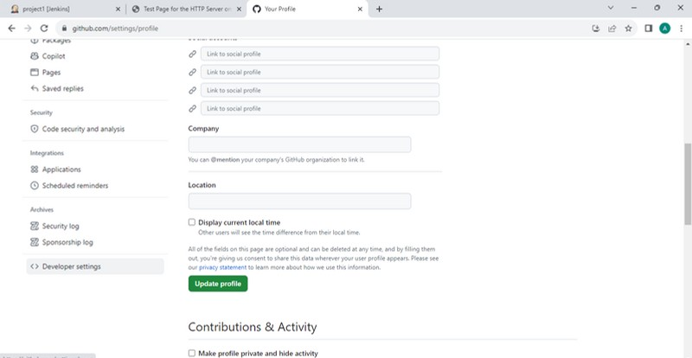


Slide 52
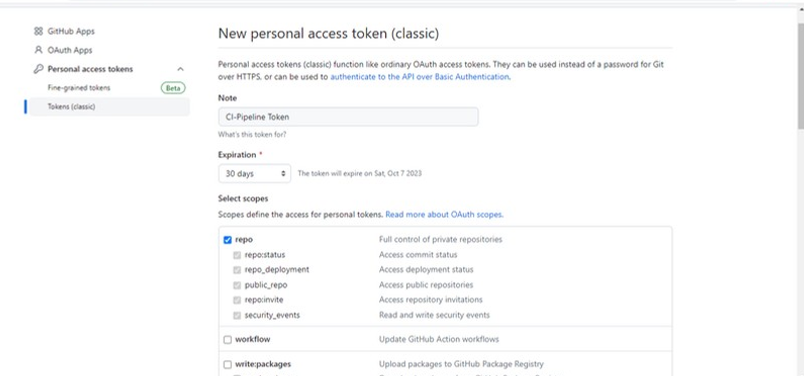




Slide 53
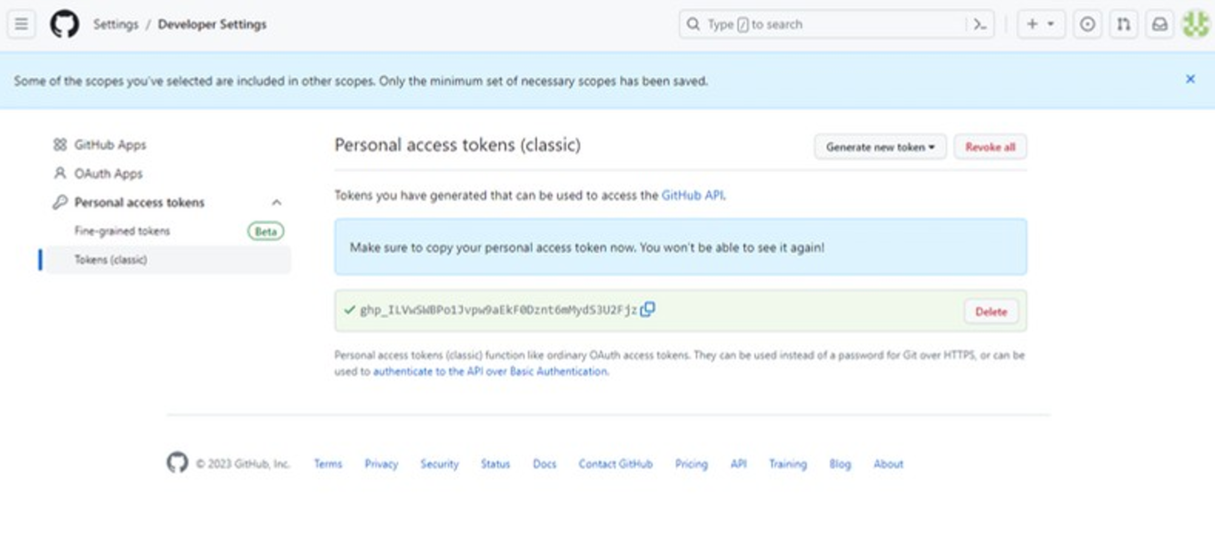


Slide 54

Now ,since the PAT is generated we can use it to push files on our project repository. Come in developer machine and fire the following commands to push html files on Github.
git push origin master
enter username
paste PAT
Below Screenshots shows the execution of the above steps :

Slide 55
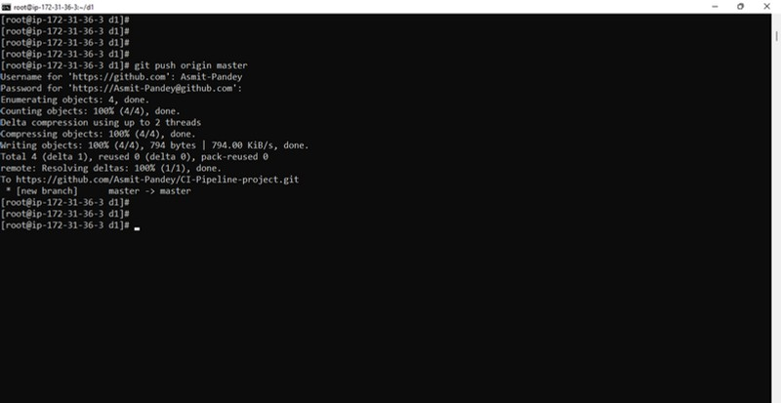


Slide 56
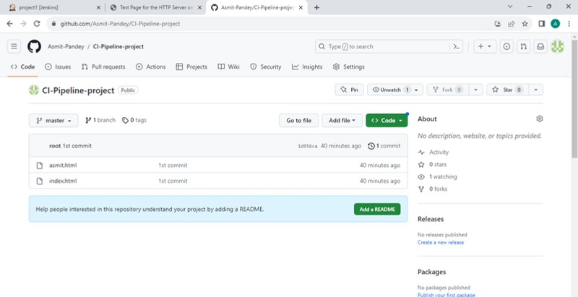

We can see that the files have been added in the project repo.

Slide 57
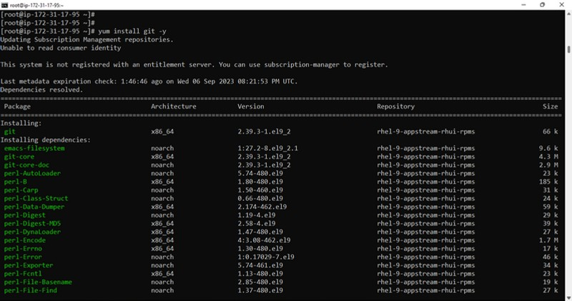
Install git on jenkins machine .

Slide 58
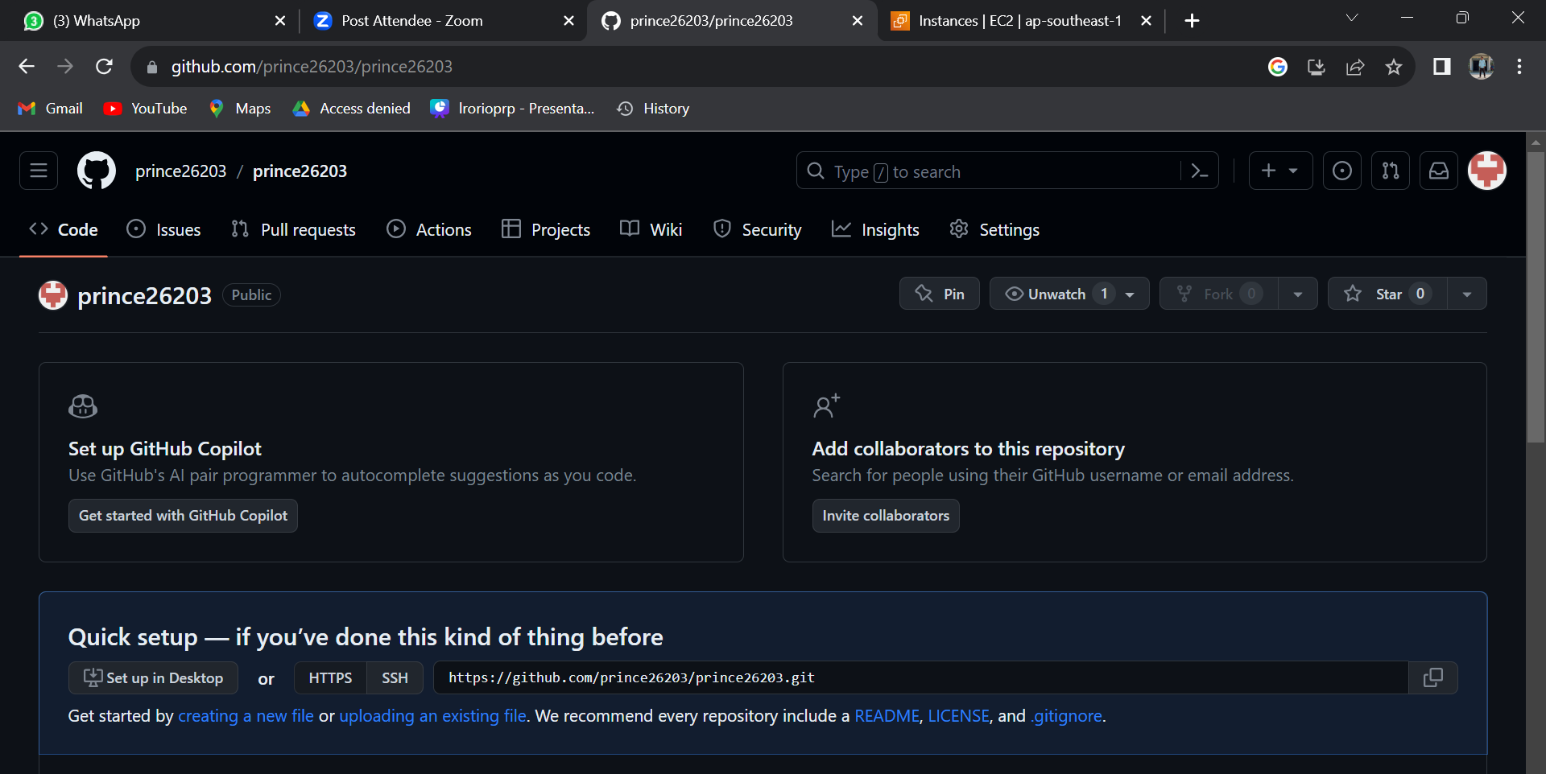


On Jenkins page go to -> project1 -> Configure -> check git and paste the copied url in repo bar .

Slide 59

Add the following two commands in execute shell box, then Apply -> Save -> build now.
sudo cp index.html /var/www/html/index.html sudo cp prince.html /var/www/html/prince.html

Slide 60

After build is successfully completed , paste the publlic ip on browser to see the output.

Slide 61

Paste “ip/prince.html” to see this on web.

Slide 62


Setting up CI Pipeline
Lets finally set up the CI pipeline using github webhooks.
On Jenkins page go to : project1 -> configure -> check “GitHub hook trigger for GITScm polling” ->apply and save -> build now.

Slide 63


Now lets add webhook.
On github project repo : Click on settings -> webhooks -> add webhook

Slide 64



Slide 65


Paste the url of jenkins in Payload URL and add “/github-webhook/” at the end -> click on add webhook.

Slide 66


Webhook added successfully

Slide 67

Now come to the developer machine and do the changes in “index.html” and “prince.html” to see if the changes are reflected automatically.
This is “index.html”

Slide 68

Modifying “prince.html”

Slide 69


Now fire the following commands to commit changes & push it to github repo :
“

Slide 70

Refresh the web pages on browser and you’ll be able to see the changes reflected automatically. Hence our CI pipeline is build and successful.

Slide 71
THANK YOU

